Slide 1

APACHE IMPALA
PRESENTED BY:
JYOSHNA BOPPIDI
AKHILA GANDRA
SATYAVRATH INJAMURI
PREETHAM POTU

Slide 2




Team Members
Jyoshna Boppidi
Akhila Gandra Preetham Potu
Satyavrath Injamuri

Slide 3






Agenda:
Impala Overview
Why Impala?
Impala Architecture
Impala vs Hive
Impala shell commands
Hands-on creating a table in Impala
Jyoshna Boppidi

Slide 4
Overview:
Open source massively parallel processing(MPP) SQL query engine developed by Cloudera.
Its written in C++ and Java.
It provides high performance and low latency compared to other SQL engines for Hadoop.
Impala uses same metadata, ODBC driver as Apache Hive, providing a familiar and unified platform for batch-oriented or real-time queries.
Jyoshna Boppidi
Notes:
MPP means, it has its own executing engine. It does not convert into MapReduce.
It is open source MPP SQL query engine for a data stored in a cluster which is running apache hadoop.
Impala takes just seconds to process the queries.

Slide 5
Why Impala?
It helps to communicate with HDFS or HBase using SQL queries in a faster when compared to Hive.
It supports in-memory data processing.
It can read almost all file formats such as Parquet, Avro, Text used by hadoop.
PIG
HIVE
YARN
IMPALA
HDFS
Jyoshna Boppidi
Notes:
It is best for same kind of queries needs to be processed several times.
Faster with MPP and no MR.
It stores data as columns.
parquet(structured),Avro (structured),Text (unstructured)

Slide 6
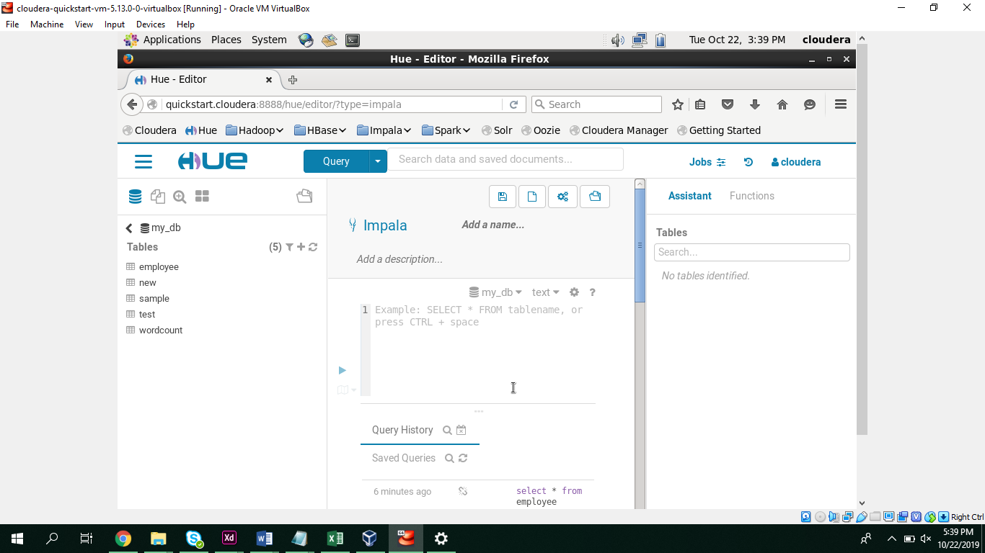
In addition to Impala shell, you can communicate with Impala using the Hue browser.
Jyoshna Boppidi

Slide 7
Impala Architecture
Impala is an MPP (Massive Parallel Processing) query execution engine that runs on a number of systems in the Hadoop cluster.
It has three components. Impala daemon (Impalad), Impala Statestore, and Impala metadata or metastore.
Akhila Gandra

Slide 8
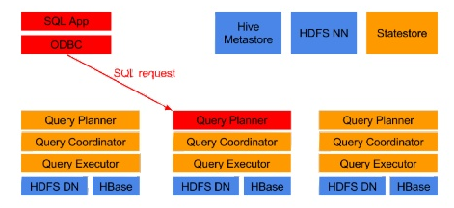
Impala Query Execution
1. Request Arrives through JDBC/ODBC
Akhila Gandra

Slide 9
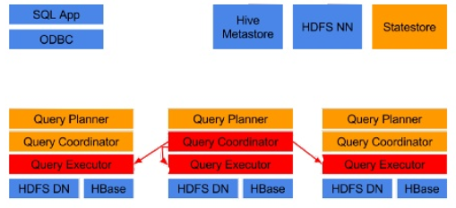
Impala Query Execution
2. Planner turns request into collections of plan fragments
3. Coordinator initiates execution on impalad(s) local to data
Akhila Gandra

Slide 10
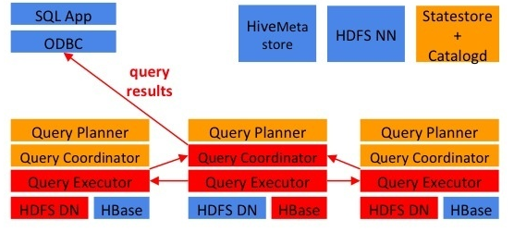
Impala Query Execution
4. Intermediate results are streamed between impalad(s)
5. Query results are streamed back to client
Akhila Gandra

Slide 11
Features of Impala
High processing speed.
Low latency.
Support parallel processing.
No map reduce.
Hadoop security.
Distributions are typically cloudera mapr, Amazon EMR.
Database of type MPP.
Preetham Potu

Slide 12
Impala Vs Hive
Impala | Hive
Impala is very fast in processing with low latency | Hive is slow with high latency compared to impala.
Impala does not supports fault tolerance and complex types. | Hive supports fault tolerance and complex types.
Impala is developed using C++. | Hive is developed using Java language.
Impala provides JDBC and ODBC API’s. | Hive provides JDBC, ODBC, Thrift API’s.
Impala provide support for interactive computing | Hive does not provide any support for interactive computing.
Preetham Potu

Slide 13
Impala shell commands
Impala shell commands are classified as:
General commands:
help
version
history
shell (or) !
connect
exit | quit
Satyavrath Injamuri

Slide 14
Query specific options:
Set/unset
Profile
Explain
Table and database specific options:
Alter
describe
drop
insert
select
show
use
Satyavrath Injamuri

Slide 15


Slide 16
References
https://www.tutorialspoint.com/impala/index.htm
https://www.simplilearn.com/working-with-hive-and-impala-tutorial
https://www.youtube.com/watch?v=3PgpOZ8SpLA
https://www.educba.com/hive-vs-impala/

Slide 17


Slide 18


